Slide 1

ICT246 Revision

Slide 2
L01:
Why are operating systems needed in computer or other devices?
An operating system (OS) is like the boss of your computer, making sure everything runs smoothly. You study it to understand how your computer works better, so you can fix problems and make things work even better. It's like knowing how to maintain and improve your favorite toy.
Why are operating systems needed in computer or other devices?
They manage all the different tasks and programs, making sure they work together smoothly without crashing into each other. Without an operating system, your device wouldn't know how to handle things like running apps, saving files, or connecting to the internet. Basically, they're the glue that holds everything together and makes your device actually usable.

Slide 3
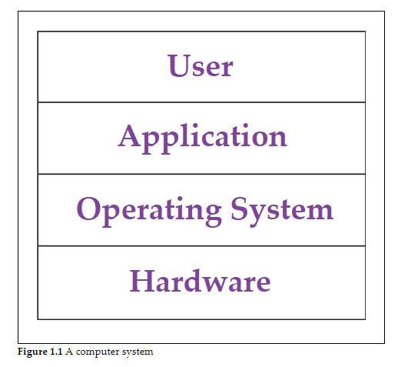

Slide 4
Core functions of OS:
Service Provided by OS | Explanation in Layman's Terms
Program Execution | The OS manages how programs run and shares resources fairly.
Access to I/O Devices | The OS makes it easy for programs to talk to things like printers.
Controlled Access to Files | The OS helps keep your files organized and safe from prying eyes.
System Access | The OS makes sure everyone gets a fair turn using the computer.
Error Detection and Response | The OS catches and deals with problems that might pop up.
Accounting | The OS keeps track of how well your computer is performing.
Efficiency | The OS makes sure your computer's parts work together smoothly.
Ability to Evolve | The OS can change to handle new gadgets and fix any problems.(new patches etc)
Convenience | The OS provides a user-friendly interface and simplifies tasks.(people who are not tech savvy can also understand easily)
Convenience
Efficiency
Ability to evolve

Slide 5
Evolving of OS:
Serial Processing→computers do not have a real OS; thus, the programmer needs to interact directly with the hardware, which is very tedious and not convenient.
Simple batch system→ has an OS, the users do not need to directly deal with the hardware, and thus it is more convenient to use.
Although the simple batch system improves the usage of the computer, it is not efficient as the processor is often idle and not used.
Multiprogrammed batch system→developed which improves the efficiency of the computer.

Slide 6
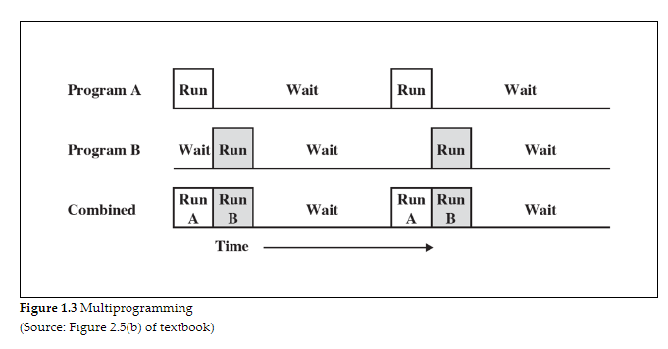
More about Multi Vs Uniprogramming:
Multi→ multiple programs are loaded into memory simultaneously.
→The CPU switches between these programs based on certain criteria, such as time-sharing or priority.
→This allows for better CPU utilization because when one program is waiting for I/O, the CPU can work on another program.
→commonly used in modern operating systems to improve overall system efficiency and responsiveness.

Slide 7
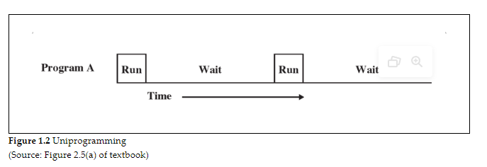
Uniprogramming→only one program is executed at a time.
→CPU executes the entire program from start to finish before moving on to the next program.
→ simpler but less efficient because the CPU may be idle while waiting for I/O operations to complete.
→less common in modern operating systems but may be used in certain embedded systems or specialized applications where simplicity is prioritized over efficiency.

Slide 8
4 functions of OS:
Major Function | Simple Explanation
Process Management | Managing what programs are running and how they use resources.
Memory Management | Making sure programs have enough space to run and don't bump into each other.
File System Management | Helping organize and access files on the computer.
Device Management | Handling communication between software and hardware, like printers or keyboards.

Slide 9
Virtualization:
What is it ?
Virtualization is a technology that lets one physical computer act like multiple computers. It's useful because it makes better use of hardware, keeps things separate so problems don't spread, allows for easy growth, and is great for testing new stuff without risking the real thing.
Why is it needed?
Virtualization is needed in operating systems because it allows one physical computer to run multiple virtual computers efficiently, offering better resource utilization, isolation of environments, scalability, and flexibility for testing and development.

Slide 10
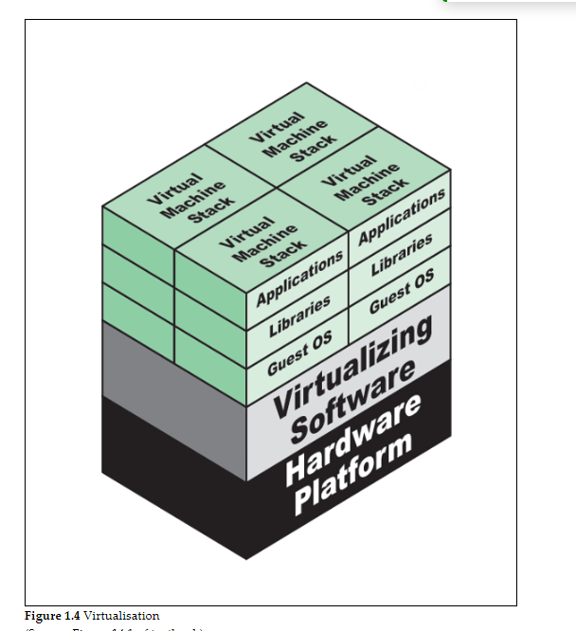
How exactly a virtualization work?
Hypervisor is needed →a software layer that enables virtualization
→sits between the physical hardware of a computer (host) and virtual machines (guests) running on it
→manage and allocate the physical resources of the host computer to the virtual machines. It creates and manages these virtual environments, allowing multiple operating systems and applications to run independently on the same physical hardware
Why organization uses it?
Consolidation →A server can run multiple VMs improving efficiency by sharing resources(in this case,instead of each VM having their own separate server,they share the resources of that one server
Rapid development →A new VM can be deployed in a very short time span as VM consists of files, which are easy to copy.
Ease of management→ if you would like to test out a new software but not sure if it affects your computer,you can run it in VM without the need to mess things up on your actual computer

Slide 11
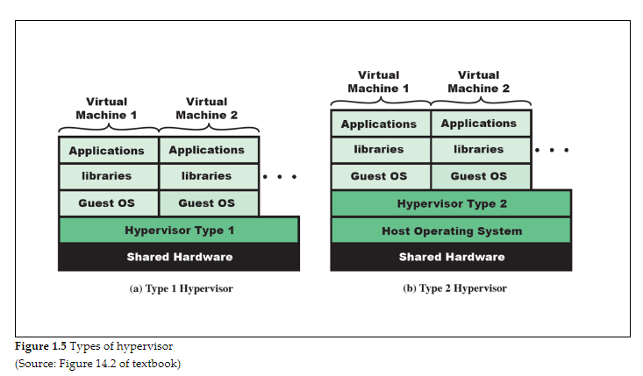
Hypervisor type 1 vs type 2:
Hypervisor 1 | Hypervisor 2
Sits between hardware and Guest OS | Sits between Host OS and Guest OS
directly control the hardware such as processor and RAM | host OS to talk to the hardware
Good performance | Lesser performance due to the additional layer
Examples: VMware ESXi, and Microsoft Hyper-V | Oracle VM VirtualBox, Vmware workstation

Slide 12
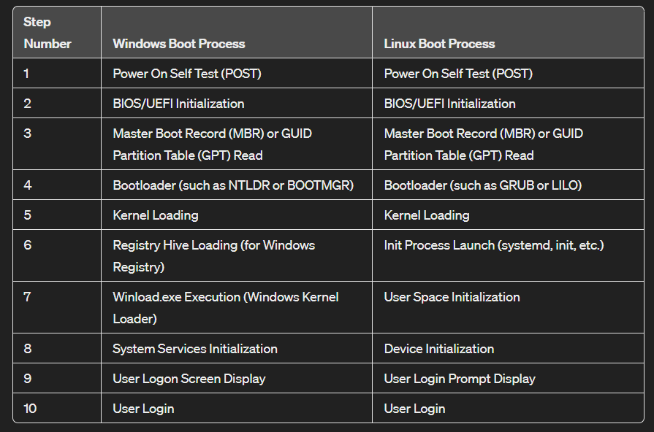
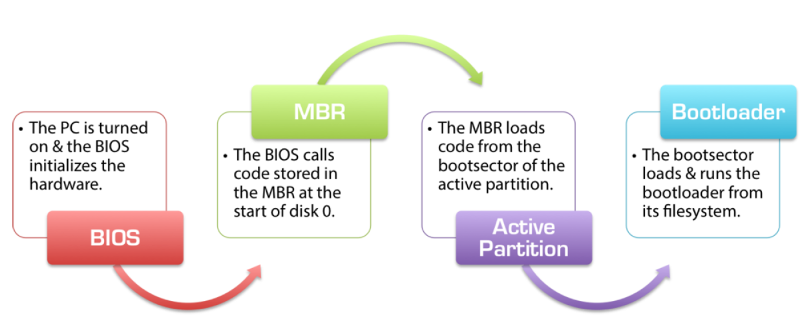

Booting process of OS
Windows Booting
BIOS(first stage boot loader-ROM)→ Windows boot manager(installed in active partition of hard disk) → start OS
Linux Booting
BIOS(ROM) → GRUB(Master Boot Record-MBR) → start of OS
Indicates the location

Slide 13
Lab Practice:
Command | Explanation
$ date | Displays the current date and time.
$ date --help | Displays help information about the date command.
$ date +%R | Displays the current time in 24-hour HH:MM format.
$ date +%x | Displays the current date in the locale's date format.
$ man date | Opens the manual page for the date command, providing detailed information on how to use it.
$ whoami | Displays the username of the current user.
$ passwd | Allows the user to change their password.
$ cat /etc/passwd | Displays the contents of the /etc/passwd file, which contains information about user accounts.
$ file /etc/passwd | Determines the file type of /etc/passwd.
$ head /etc/passwd | Displays the first 10 lines of the /etc/passwd file.
$ head -3 /etc/passwd | Displays the first 3 lines of the /etc/passwd file.
$ tail /etc/passwd | Displays the last 10 lines of the /etc/passwd file.
$ tail -4 /etc/passwd | Displays the last 4 lines of the /etc/passwd file.
$ wc /etc/passwd | Displays the number of lines, words, and bytes in the /etc/passwd file.
$ wc -l /etc/passwd | Displays the number of lines in the /etc/passwd file.
$ wc -w /etc/passwd | Displays the number of words in the /etc/passwd file.
$ wc -c /etc/passwd | Displays the number of bytes in the /etc/passwd file.
$ ls | Lists files and directories in the current directory.
$ ls -l | Lists files and directories in the current directory in long format, providing detailed information.
$ ls -la | Lists all files and directories in the current directory, including hidden ones, in long format.
$ history | Displays the command history of the current session.
$ !10 | Executes the 10th command from the command history.
$ ip addr | Displays information about network interfaces, including IP addresses.
$ man passwd | Opens the manual page for the passwd command, providing detailed information on how to use it.
$ sudo shutdown -h now | Shuts down the system immediately. The sudo command is used to run the shutdown command with superuser privileges.

Slide 14
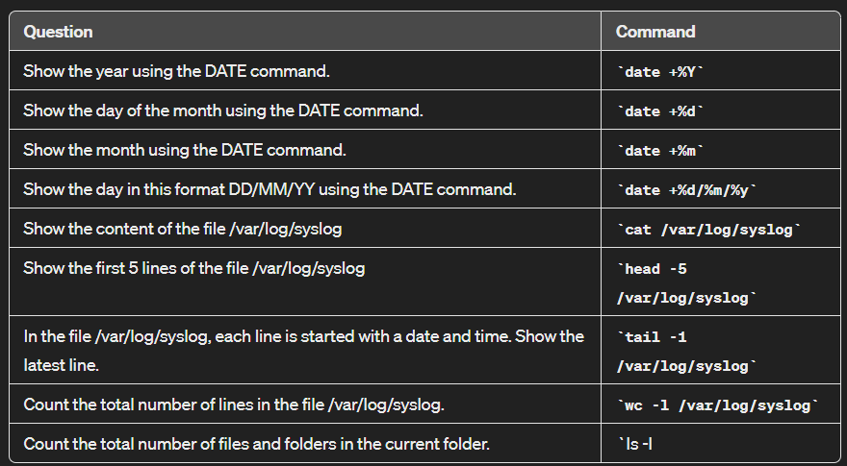
Date Formatting commands:

Slide 15
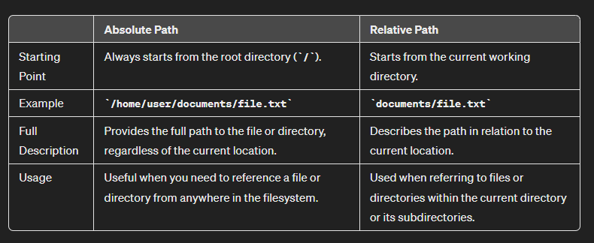



L02: File system management
File system management is impt → perform functions and ops such as read,creat,delete,close and write.

Slide 16
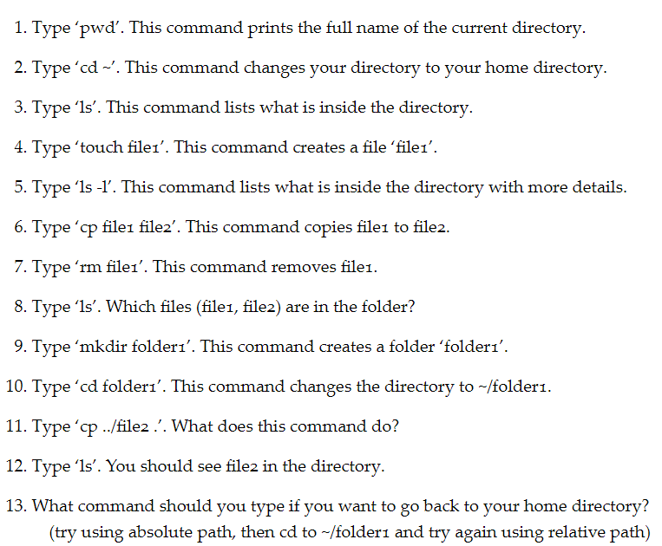

From study unit 2:

Slide 17

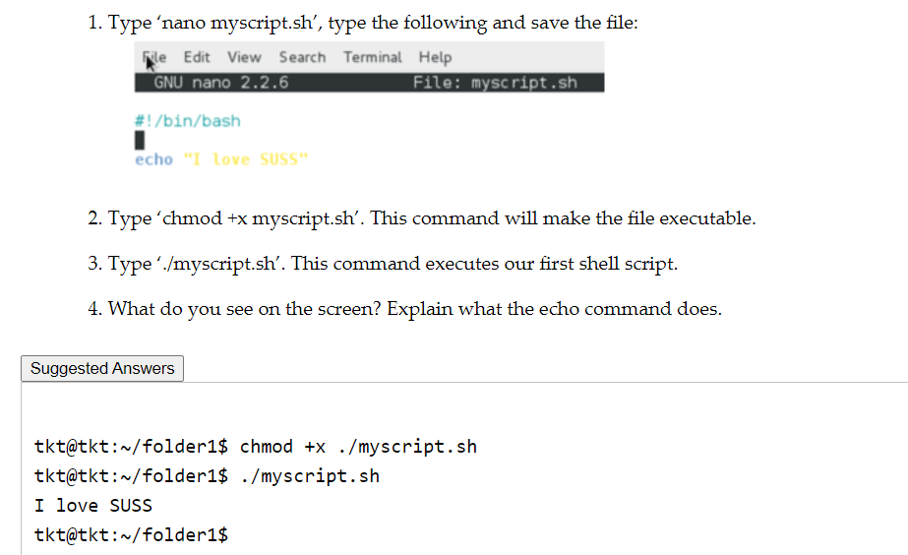
Create a bash script:
Qn:Why do we need to make this an executable? Why is it not auto enabled?
Security: Making a script executable requires explicit permission from the user, helping to prevent accidental execution of potentially harmful scripts. It ensures that users consciously decide which scripts they want to execute.

Slide 18
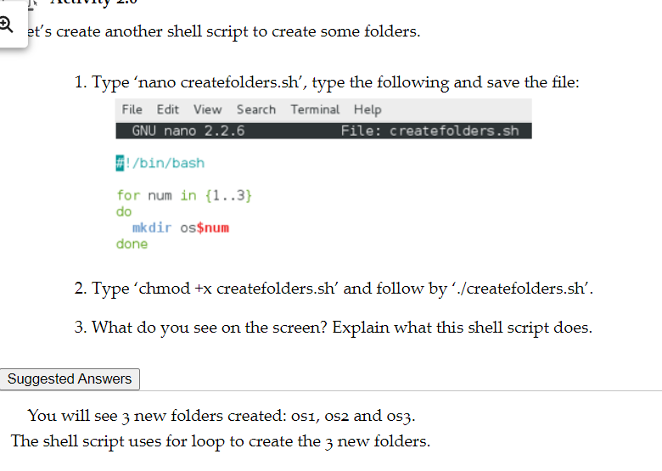
#Make folder “OS” and store it in a variable named “$num”

Slide 19
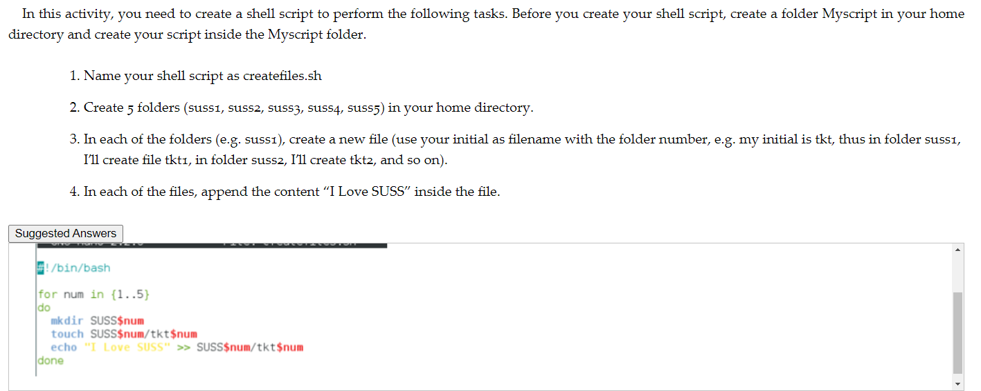


When you create the files,its empty,so now use echo to input a message “I love SUSS” in the files

Slide 20
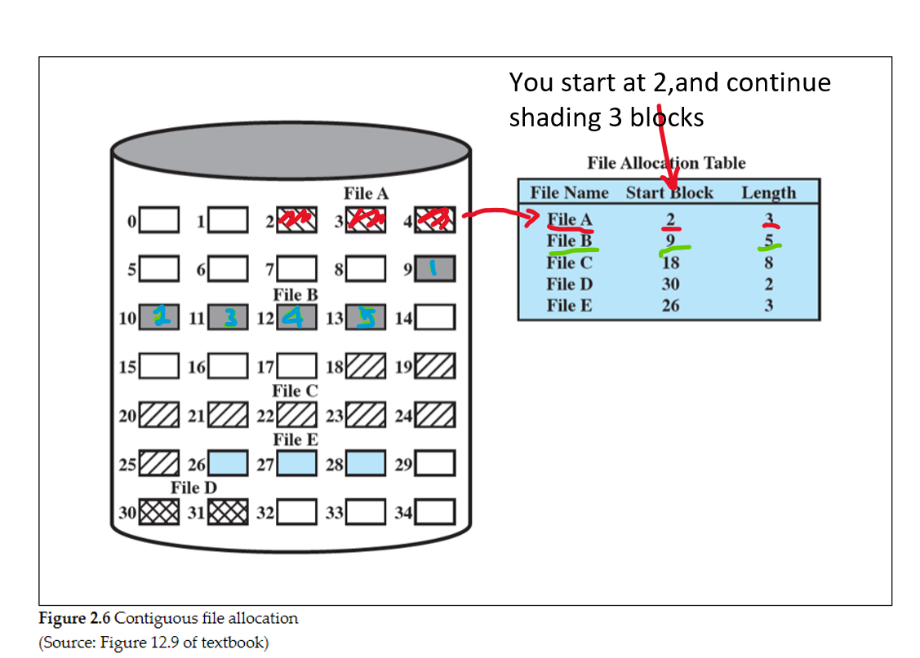
File Allocation Methods :
Contiguous
Each file is represented by a single line which shows the start block and length of the file
Easy to implement and to retrieve a single block
Contiguous limitations:
External fragmentation →When files are created, deleted, and modified over time, the available disk space becomes fragmented into smaller, non-contiguous chunks. The file system will have difficulty in finding space to store longer files.

Slide 21
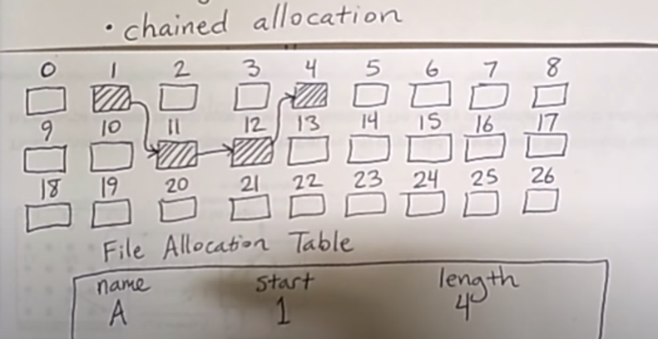
Chained allocation:
Chained:
Allocation is done on individual block
Each block is responsible to point to the next block(can be random) and a pointer is used
Each file only needs to know the start block, and with that no fragmentation issue
Limitations of chained:
With chained allocation, different parts of a file are stored in different places on the disk, so if you need to read or write several blocks of a file, the system has to jump around the disk to find them. This can slow down performance because it takes time to move the disk's reading head to different locations.

Slide 22
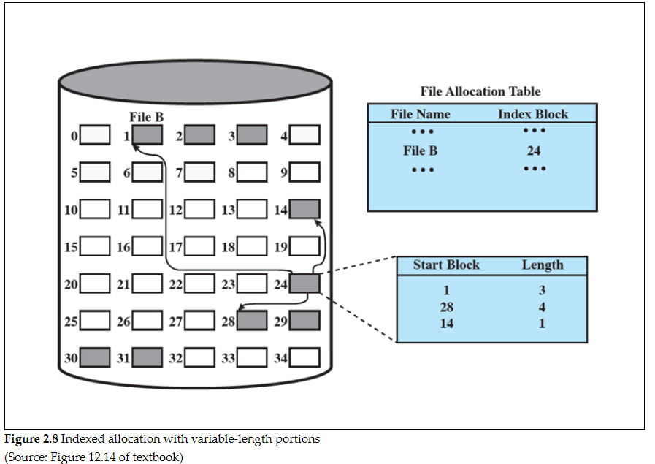
Indexed allocation:
Index
File indexes are kept in a separate block different from FAT
Allocation can be either fixed size or variable size portions
Each file is represented by a single line that shows the index block
Index block shows the actual location of the files
Advantages of Index allocation:
No external fragmentation issue
And variable size portions will improve the locality

Slide 23
L03:Access control and system security
What is access control in OS?
Ensures that controls which users can perform what tasks within an OS,for example if you have the permissions to install a software it will continue, but if you don’t it will prompt an error message.
Why do we need one in OS?
If there is no access control, that means everyone can perform any tasks, and that is very dangerous, especially for a server OS. You will not want a user from a marketing department to delete sensitive files from an accounting department. It will also improve the security as if the OS is infected by malware, and the malware does not have the permission, it will not execute.
3 types of access control
Mandatory Access Control
Access is given based on security labels and security clearances
Is strict and can be applied to military environment
Discretionary Access Control
Controls is based on subjects and on access rules if they can perform certain actions based on the objects
Allows each user to control access to their own objects
Flexible and it allows the subjects to grant access to other objects
Can become messy(limitation)
Role Based Access Control
Access ig given based on the job functionality that the user have and on rules that states which roles have what access to each object
Access are given to roles instead of individual users, and the users are assigned to different roles
In general, an administrator assigns a user to a particular role that has certain rights
not as flexible as DAC, but it is easier to manage as it is centrally controlled
©

Slide 24
Access control in Linux:
Qn:How do you change the permission of the file suss1 to rw-r-xr-- ?
ls –l <filename>
Default Permissions in numeric value
Read (4)
Write (2)
Execute (1)
Total = 7
 | Users | Group | Others
Read | 4 | 4 | 4
Write | 2 | 0 | 0
Execute | 0 | 1 | 0
Total | 6 | 5 | 4

Slide 25
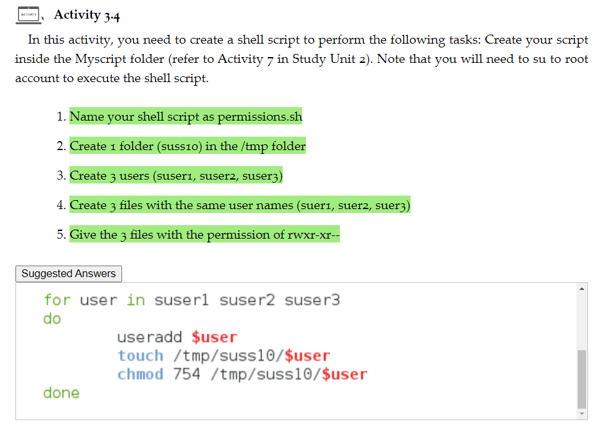

Slide 26
System Security- is the process of preventing attempts to gain unauthorized privileges by a user or malicious software
Intruders
Hackers who poise threats to OS
Masquerader(outside the network) – pretending to be another user
Misfeasor(inside the network) – actual user who misuse their privileges to access unauthorized things
Clandestine user(either someone from inside or outside the network)-one who manages to get control of the root and bypass access controls
Malicious software
Independent (self contained)- can run on its own by the OS, without users interaction
Eg.Worms
Needs a host program(parasitic) – needs user interaction to spread the virus like opening an infected file
Eg.Virus
Buffer Overflow
Overwriting memory locations
Attackers can gain control of the program and using Metasploit against unpatched system,can lead to a remote shell which means attacker is able to execute commands without authorization.

Slide 27
Countermeasures-how to prevent them?
Authentication – make sure the OS knows you are the person who claims to be
Eg- when your system boots up,you are required to input username and password
Nowdays,FaceID and biometrics such as fingerprints are used to identify and verify you are a legitimate user
Access controls- after authenticating you are a legitimate user,OS is to give you proper access controls
Buffer overflow countermeasures
Run time defense – aims to detect and stop the executing of the programs
Compile time defense – aims to resist by hardening the programs
Other than the above
You can use anti malware systems – IPS(prevention system)-alerts and resists the attacks to the user, Paloalto firewall etc

Slide 28
Why and how to harden them?
OS gives the flexibility to users to configure their own settings because the purpose is to use the system with ease with maximum functionality
It allows hackers to infiltrate the network very easily with open services and ports
Steps to harden OS:
OS installation and patching
Make sure you install the OS properly and minimise the software packages included
Booting process such as specifying a password in BIOS to prevent attackers from getting physical access to your computer
For example,your computer is lost and via a USB,attackers can input it and change the BIOS to boot up from their thumbdrive & performing malicious tasks – so password is important
Remove unnecessary services, applications, and protocols
System planning needs to be done to resolve conflict of usability and security
Unnecessary services should not be installed by default to reduce the possibility of OS being exploited
Configure users, groups, and permissions
Users & groups-access controls should be given properly
Users will not have more privileges than they are required to do their work
Any additional groups that users are in should be accounted for
Install and configure additional security controls
antivirus software, host-based firewall, host-based intrusion detection system
Test the system security
To make sure that what you have implemented works, you will need to test the system. Usually, the organisation has a checklist, and this checklist is specific to the different OS being used.

Slide 29
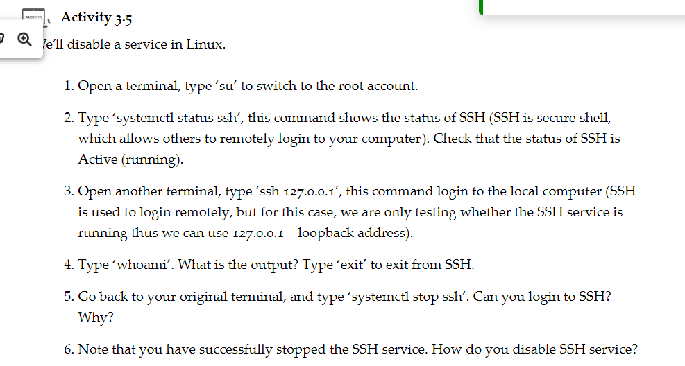
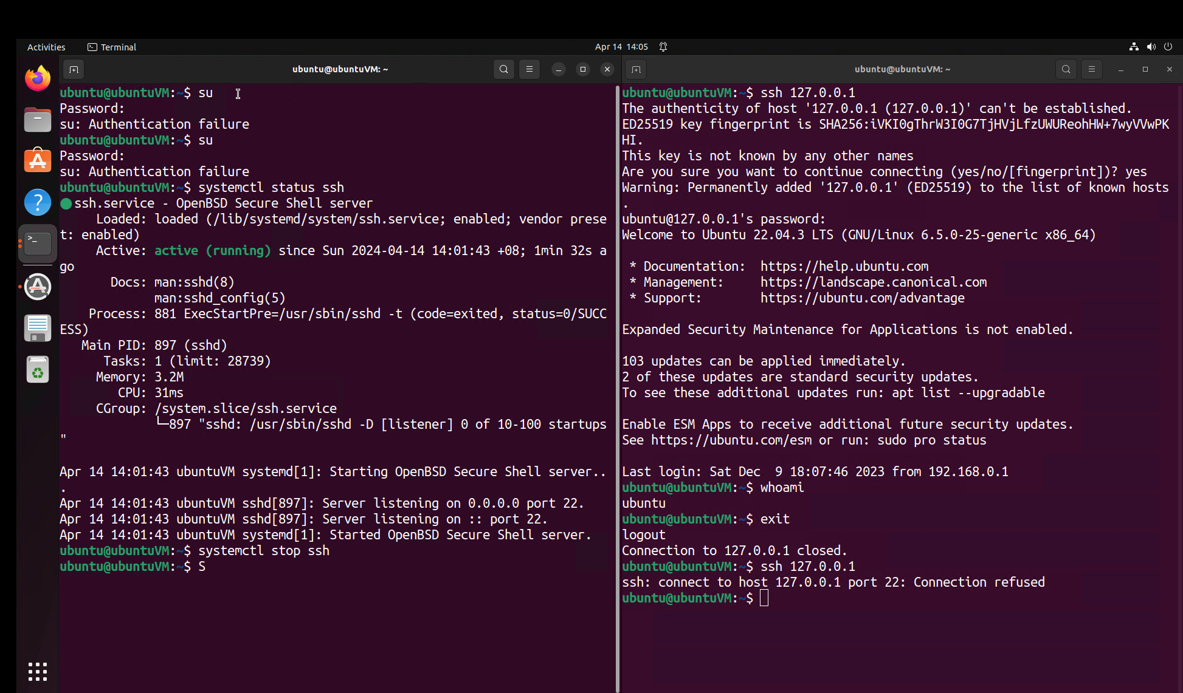
Disabling of SSH-Linux:

Slide 30
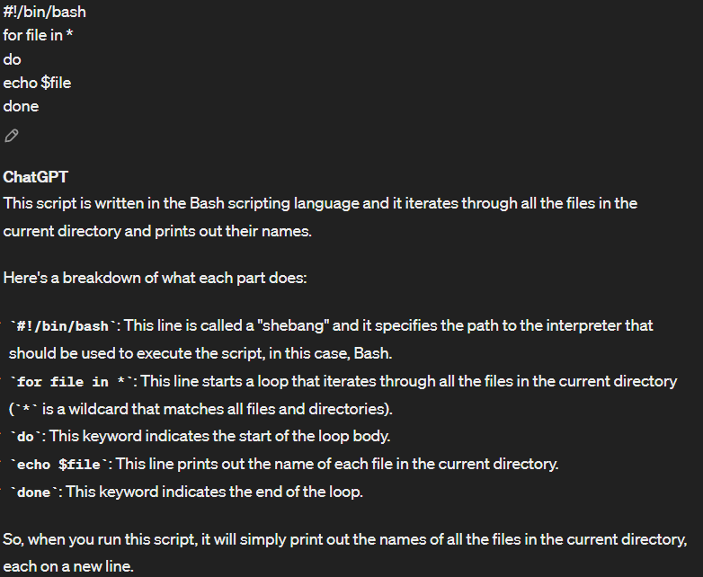
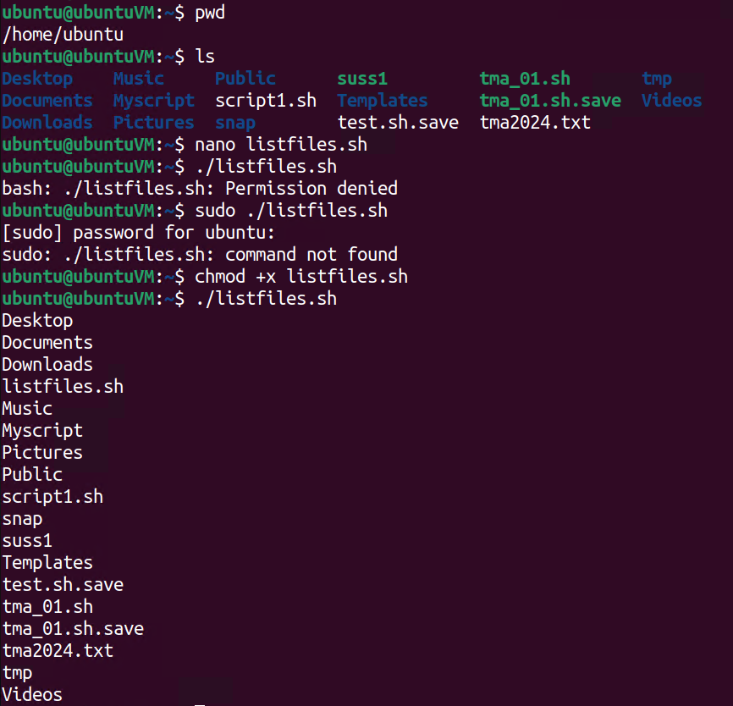
Current directory
Listing the files in dir
Create a bash script to list the files
Change permissions to execute the file

Slide 31
/etc/passwd: This file stores essential information about user accounts on the system. Each line in the file represents a user account and contains various fields such as username, user ID (UID), group ID (GID), home directory, and shell.
/etc/shadow: This file contains encrypted password information for user accounts. It is typically readable only by the root user and contains more sensitive information than the /etc/passwd file, including password hashes and password aging settings.
/etc/group: This file contains information about groups on the system. Similar to /etc/passwd, each line represents a group and contains fields such as group name, group ID (GID), and a list of usernames that are members of the group.
These files are crucial for managing user accounts, permissions, and access control on a Unix-like system. They are typically located in the /etc directory, which stores configuration files for the system. Access to these files is restricted to privileged users to maintain system security and integrity.

Slide 32
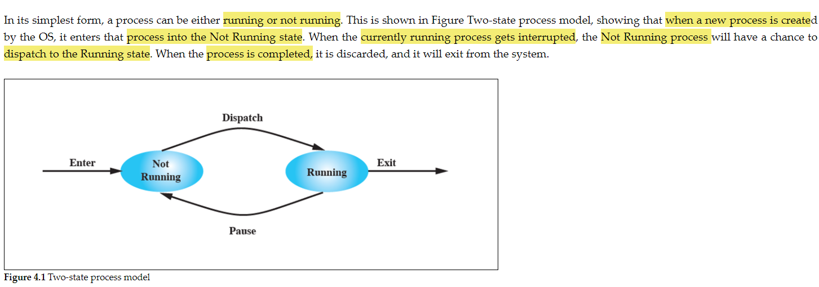
L04:Process Management
When a program is running,a process is created and managing that is important for OS
Limitations of two state process model –is very simplistic
Some processes that are not running will be blocked as waiting for I/O operation and will never ever go into dispatch into running state

Slide 33
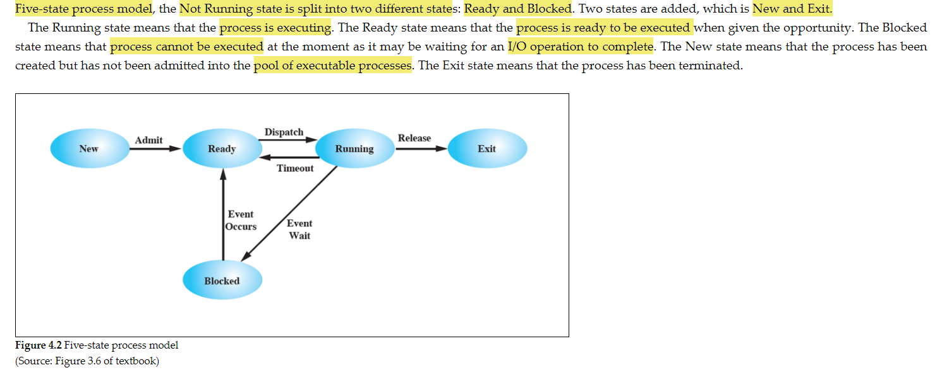
How to counter the limitations?

Slide 34
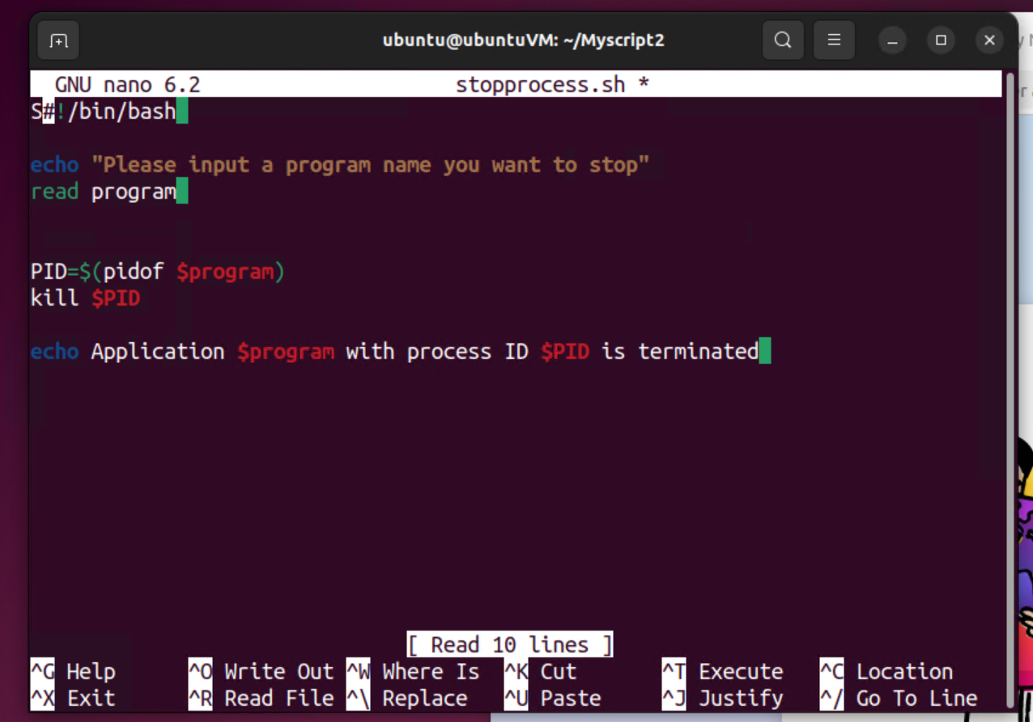
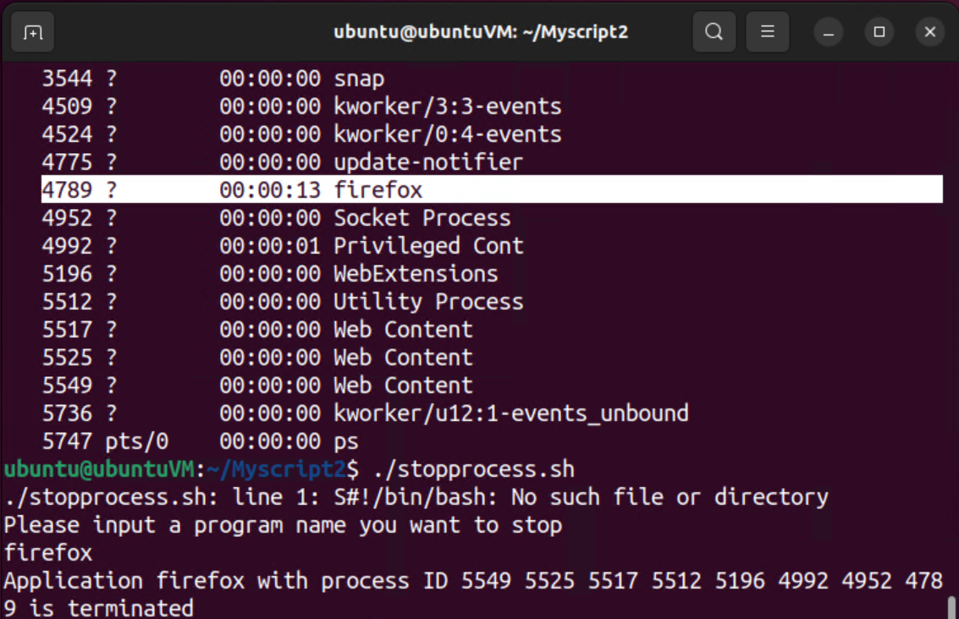

Slide 35
Deadlock
2 processes sharing the same resources are preventing each other from accessing it,so both of them are in blocking state
Process A opens a file, called file1, and process A needs another file, called file2 to proceed. Process B opens a file, called file2, and process B needs another file, called file1 to proceed. If processes A and B both do not close the files that they have opened, neither processes will be able to proceed. This is called starvation, and it results in a deadlock situation.
Conditions of Deadlock:
Mutual exclusion –one resource allocated to one process at a time :only one process can write to a file at any time
Hold and wait – a process can hold a resources while waiting for its allocation of other resources
Preemption – resources cannot be removed from a process holding them
Deadlock will only occur if circular wait happens. That means each process holds at least one resource needed by the next process, and it results in a circular wait.

Slide 36
How to prevent a deadlock?
Deadlock prevention in operating systems can be achieved by targeting the conditions necessary for deadlock: mutual exclusion, hold and wait, no preemption, and circular wait.
Mutual Exclusion: Cannot be prevented as it's essential for certain resources. For instance, exclusive access to a file prevents data corruption.
Hold and Wait: Can be prevented by requiring processes to request all needed resources at once, blocking until all are available.
No Preemption: Achieved by forcing processes holding resources to release them when requested by others.
Circular Wait: Prevented by establishing a linear order of resource types, ensuring processes only request resources in a predetermined sequence.

Slide 37
How to avoid deadlock?
A process is not started if its demands may lead to a deadlock later.
A process is not granted an incremental resource request if the allocation may lead to a deadlock later.
Deadlock detection and Recovery:
In deadlock detection, the OS will check for deadlock periodically. Once deadlock is detected, the OS can then use a strategy to resolve the deadlock. One of the strategies which is commonly used in OS is to abort and restart all deadlocked processes.

Slide 38
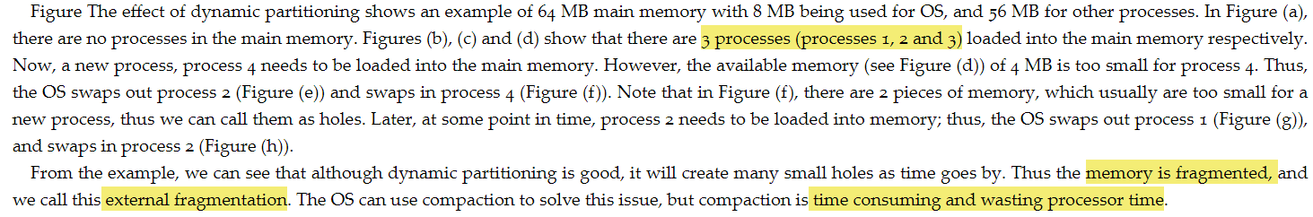
Dynamic partitioning:
Main operation of memory management is to bring processes into main memory,so dymanic portioning allows to allocate the process exactly the memory it requires.
Limitations:
As times goes by,it will create a lot of holes causing external fragmentation and compaction is better but that’s time consuming and wasting processor time.

Slide 39
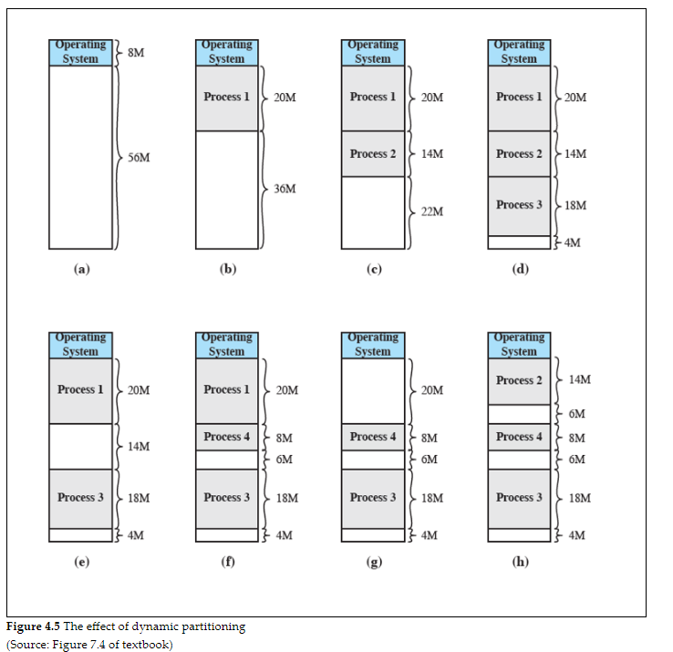

Slide 40
Placement algorithm:
Best fit
Auto detect the best free block that is closest to the size it needs to swap with
Worst in performance
result in very small holes that are too small to be allocated to processes. Thus, the OS needs to perform memory compaction more frequently than other algorithms.
First fit
First available block that is large enough from the beginning of the memory
Fastest and the best
Next fit
Selects the free block that is large enough from the last placement location of the memory
Slightly worse than of first fit

Slide 41
How to overcome dynamic partitioning?
Paging is used to overcome the memory fragmentation problem
Divides memory and processes into equal sized chunks that are small

Slide 42
Disk performance:
T = b/rN
T = transfer time
b = number of bytes to be transferred
N = number of bytes on a track
r = rotational speed, in revolutions per second (rps)
Total avg time = Total seek time + 1/2r + b/rN

Slide 43
RAIDs:
Fault tolerance refers to whether the system can resist faults, either hardware or software faults. Generally, this involves redundancy, and it implies more expensive cost.
RAID is one example of fault tolerance
Stores parity bits so it can rebuild the data if there is a disk failure
RAID 0-6 (2 and 3 are not used in practice)
Raid 0
Data is divided into stripes and distributed accross the arrays
Each disk contains part of every file allowing parallel access to data
Improves performance multiple disks can be read or written concurrently
Does not provide redundancy ,if one disk fils,all data stored on the disk is lost
Used for non critical data,inexpensice and good performance

Slide 44
Raid 1
Provides redundancy,duplicates two sets of data aka mirroring
Raid 4
Uses one disk to store parity bits,allows upto one disk failure
If one disk fails,the original data can be retrieved by the parity disk
Raid 5(aka raidz in LINUX)(useable harddisks -1)* usuable space
Strip parities instead of using one whole disk for parity
Original data can be retrieved by the parity strips across the other disks
Widely used in practice
Uses one parity block per strip
Raid 6 (useable harddisks -2)* usuable space
Uses two different parity calculations and is stored in different disks
two different algorithms are used, P and Q; thus, the data can be re-generated even if two disks fail at the same time.

Slide 45
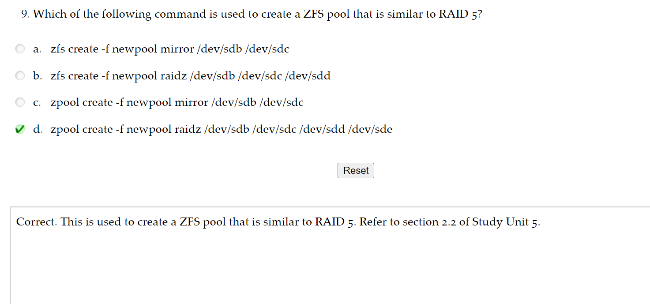

Slide 46
Limitations of RAID:
Not a full proof system
Does not always ensure that data is readily available in OS
Data can still be corrupted by different errors
Ways to mitigate it:
Z file system(ZFS)
Uses checksum to preserve integrity of data
Provide volume manager and can provide diff raid levels
To check available disks
ls /dev/sd*
To start zfs
modprobe zfs
To create a zfs pool
zpool create <pool name> raidz2 /dev/sda /dev/sdb<all the disks>
To create file system
Zfs create <pool name>/<filename>
So ZFS includes all typical RAID levels that you normally will come to expect, they just go by different names. For example, a RAIDZ1 can be compared to a RAID5, giving you the ability to lose a single drive in a pool, and RAIDZ2 can be compared to RAID6, allowing the loss of two disks per pool.

Slide 47
System Management:
System monitoring → perofmance can be monitored and problems can be detected early (pro active)
Linux → use commands such as ps and top
To check if a process is using too many resources
If system memory is enough and if any process is behaving unusually
To check a process PID
ps –e | grep firefox
To show cpu and memory usage of firefox
ps –p <PID> -0 “%cpu %mem”
Monitor real time usage os
Top
To check for free space in RAM
free
Or df
Or df –h (gives a human readable format)

Slide 48
Monitoring of system log files
Log files are helpful to know whether our system is behaving weirdly or the errors
– Folder /var/log/→folder of where the system logs contains
– cat /var/log/syslog→ contains kernel messages & other system related
– tail -10 /var/log/syslog→dislays last 10 lines of the syslog
– tail -10 /var/log/auth.log→last 10 lines of the auth like login attempts or auth failure
– grep -i tkt /var/log/auth.log→

Slide 49
Disk Quota
Common feature
Prevent an os partition from running out of space
Prevents single user from using up the entire file space
This is used in companies to prvent users to control how much disk space they use
As an example, an organisation can grant the marketing department more disk space than the sales department
Service provider such as web hosting companies can use disk quota to grant different levels of disk space to different clients based on the price plan

Slide 50
Mobile OS:
Smaller screen
Needs to access network almost all the time
Lesser memory and storage space than a desktop
Does not cater multi user
Adding devices are not critical
Need the ability to withstand powerlife

Slide 51
Android OS:
Based on linux
Widely used
Layers of Android Architecture:
Application layer
Users directly access apps such as SMS,Mail,Browser etc and its developed using Java
Application framework
Reusing the component are encouraged
Resource manager, windows manager eases developer’s life
Standardersation should be implemented using APIs
System libraries
Often written in c/c++
Used to store data usually in SQL database
Consists of useful functions
Android runtime
Software is not compiled directly on the device
Uses bytecode format and then transform into native instruction on the device
Linux Kernal
Bigger than android
Because android will remove the unnecessary drivers which are not required in mobile devices

Slide 52
iOS
iPhone uses multicore processor
Grand central dispatch(GCD) to support multicore processor
Makes in convenient for developers because they can split programs into a lot of threads making the program more efficient
User will feel that their phone is running smoothly even when a lot of apps being opened.
Layers of OS:
Cocoa touch
Similar to Android OS where in this case is the application layer and deals with framework and provides API
Media layer
Support framework the deals with Media,video,audio and graphics
Core services
Provides core services and framework such as address book and core location
Core OS
Provides low level features such as security services framework

